Slide 1
Containerization (with Docker)
Professorship of Open Source Software
Friedrich-Alexander University Erlangen-Nürnberg
ADAP B01
Licensed under CC BY 4.0 International
Notes:
It is Friedrich-Alexander University Erlangen-Nürnberg – FAU, in short.
Corporate identity wants us to say “Friedrich-Alexander University”.

Slide 2
Modern Tech Stacks
Modern Applications use many different technologies, esp. service-oriented architectures
Managing a complex tech stack on one machine is hard
Managing a complex tech stack on different machines and environments is even harder
  Especially if setting up the environment is done manually
 | Service A (Java) | Service B (Java) | Service C (NodeJS) | Frontend (VueJS) | Database A (PostGreSQL) | Database B (MongoDB)
Laptop Dev A | Java 11 | Java 11 | Node 12.10.0 Current | Node 12.10.0 Current | - | MongoDB 4.2
Laptop Dev B | Java 13 | Java 13 | Node 12.10.0 Current | Node 12.10.0 Current | Postgres 11.5 | -
QA Servers | Java 11 | Java 11 | Node 10.16.3 LTS | Node 10.16.3 LTS | Postgres 10.10 | MongoDB 4.0
Prod Servers | Java 8 | Java 8 | Node 10.16.3 LTS | Node 10.16.3 LTS | Postgres 10.10 | MongoDB 4.0

Slide 3
Modern Tech Stacks
Modern Applications use many different technologies, esp. service-oriented architectures
Managing a complex tech stack on one machine is hard
Managing a complex tech stack on different machines and environments is even harder
  Especially if setting up the environment is done manually
Service C crashed the
whole machine, so
Service A and the
Frontend is down, too!
Everything
finally works!
 | Service A (Java) | Service B (Java) | Service C (NodeJS) | Frontend (VueJS) | Database A (PostGreSQL) | Database B (MongoDB)
Laptop Dev A | Java 11 | Java 11 | Node 12.10.0 Current | Node 12.10.0 Current | - | MongoDB 4.2
Laptop Dev B | Java 13 | Java 13 | Node 12.10.0 Current | Node 12.10.0 Current | Postgres 11.5 | -
QA Servers | Java 11 | Java 11 | Node 10.16.3 LTS | Node 10.16.3 LTS | Postgres 10.10 | MongoDB 4.0
Prod Servers | Java 8 | Java 8 | Node 10.16.3 LTS | Node 10.16.3 LTS | Postgres 10.10 | MongoDB 4.0
Not on my
machine...
Which new dependency
do I have to install again?
Somehow broke the
production! Hm, on
my local machine
it worked??!?

Slide 4
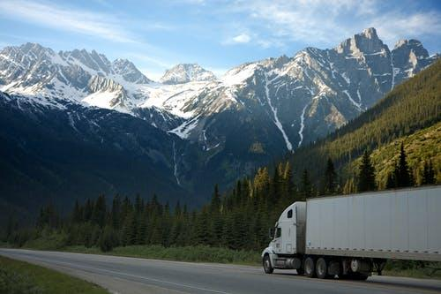
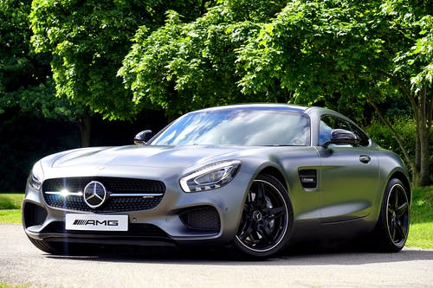
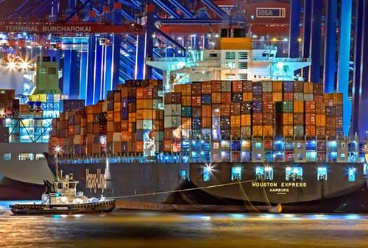
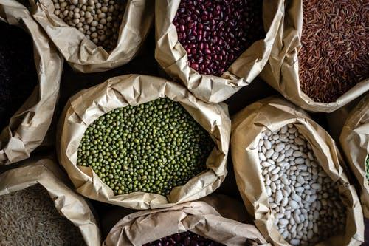
The Transportation Problem
How to transport things of different sizes effectively?
shippable containers
Images from https://www.pexels.com/

Slide 5
How Docker Summerize Itself in three Words
Build
Share
Run

Slide 6
Advantages of Containerization
Standardized packaging for software and its dependencies
Consistent environment
  Correct libraries and runtimes
  Same environment for dev, QA and production
Isolation / Sandboxing
  No impact on other applications
  Additional security layer (if configured correctly)
Build once, run anywhere
  Developer machine vs. on-premise vs. cloud
  Linux vs. Windows vs. Mac
Infrastructure as Code
  Flexibility
  Code = documentation

Slide 7
Virtual Machines vs Containers
Virtual Machines (VMs) vs. Containers
App 1
App 1
App 2
App 1
App 3
VM
Bin / Libs
Bin / Libs
Bin / Libs
Bin / Libs
Bin / Libs
App 1
App 1
App 2
App 1
App 3
Container
Guest OS
Guest OS
Guest OS
Guest OS
Guest OS
Bin / Libs
Bin / Libs
Bin / Libs
Bin / Libs
Hypervisor
Container Runtime
Host OS
Host OS
HW
HW

Slide 8
Virtual Machines vs Containers
Benefits of lightweight containers compared to VMs
  Share host’s OS with container results in
    improved deployment speed
    faster reboots
    less resource overhead
      memory and storage
App 1
App 1
App 2
App 1
App 3
Container
Bin / Libs
Bin / Libs
Bin / Libs
Bin / Libs
Container Runtime
Host OS
HW

Slide 9
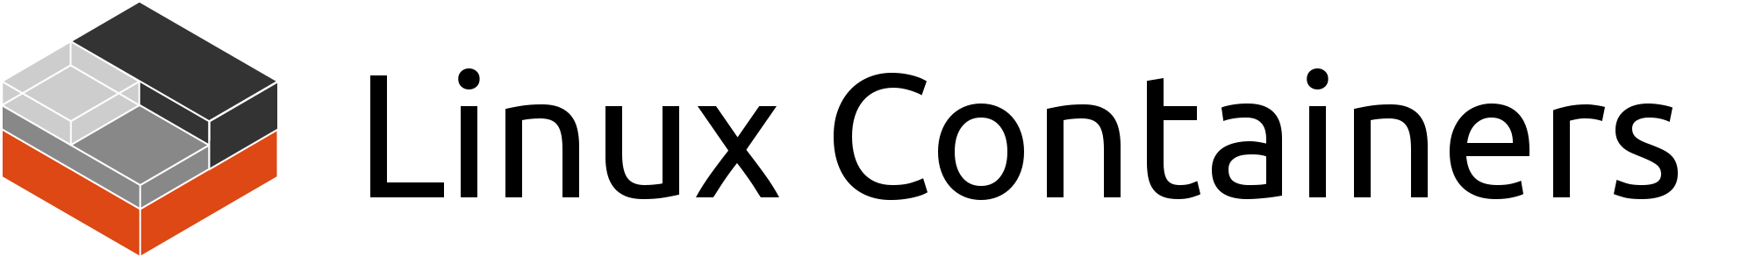

Container Standards
Standardization: Open Container Initiative (OCI)
  Open governance structure to create open industry standards for containers
  Runtime Specification
  Image Specification
Linux Containers (LXC)
  OS-level virtualization technology
    Use Linux kernel features
    Like namespaces and control groups
  Uses virtual environments (VE) to run isolate applications or an entire OS
Docker is an extension of LXC with improved capabilities
  Provides a high-level API
  Versioning of containers
  Container reuse (base images)
  A public registry to share containers
  Available as Community Edition (CE) or Enterprise Edition (EE)
https://discuss.linuxcontainers.org/uploads/default/original/1X/9a2865f528f7b846cda54335dec298dda6109bb3.png
https://www.docker.com/sites/default/files/d8/2019-07/Moby-logo.png

Slide 10
Docker Concepts
Docker Client and Daemon
  Docker Daemon is responsible for
  all actions that are related to containers
  Receives commands from Docker Client
  by CLI or REST API
  Docker Client and Daemon can be on same
  machine, but don’t have to (client-server architecture)
Docker Images
  Executable package to run an application
  Includes the code, a runtime, libraries,
  environment variables, and configuration files
Docker Containers
  Execution environment for Docker
  Instance of an Docker Image (created from it)
Docker Registry
  Share Docker Images
  Public vs. private
Docker Registry
Image A
Image B
Image C
Image D
Push / Pull
Image A
Image B
Container 1
Container 2
Container 1
Container 2
Docker Daemon
CLI / REST API
Docker Client

Slide 11
Docker Workflow
Codebase
Docker Registry
Java
File
Java
File
Java
File
Java
File
docker push
<image name>:<tag>
docker pull
<image name>:<tag>
Dockerfile
docker run
<image name>:<tag>
Docker Conatiner
(running)
Docker Image
docker build -t
<image name>:<tag>
<path to Dockerfile>

Slide 12
Docker Container Lifecycle
Docker Image
docker create
docker run
docker restart
created
docker start
running
docker rm
docker start
docker unpause
docker stop /
docker kill
docker pause
deleted
docker rm
stopped
paused

Slide 13
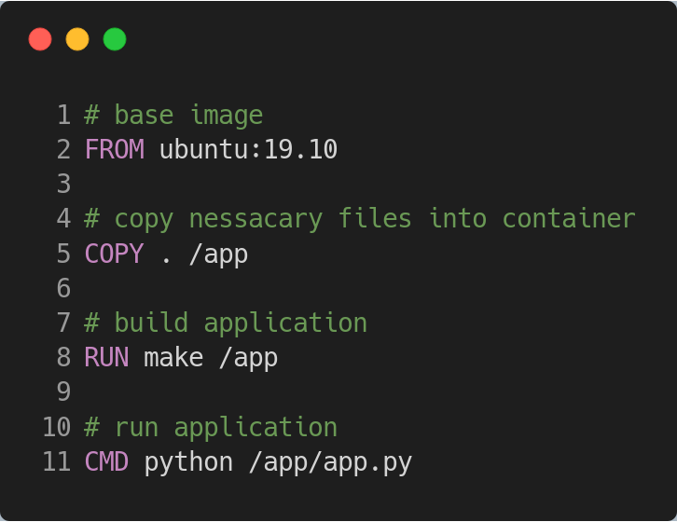
Docker File
A Dockerfile is a text document which describes how a Docker image is assembled
A Dockerfile starts with the definition of the base image
Each instruction creates a new layer on top of the previous image layer
CMD and ENTRYPOINT define the command to be executed when running the image

Slide 14
Docker Images
OOP analogy: Image is like a class and a container is like an instance of a class
Images are designed to be composed of other images
Union File System (UFS) is the key technology used for Docker images
  UFS allows to overlay different file systems and provide a view as a single file system on it
  Docker allows different implementations of the UFS, e.g. AUFS, Overlay, or BTRFS
Image layers
  Are committed by Copy on Write (CoW)
  Are read only
  Can be reused to network traffic and storage consumption
  Reuse of image layers increasing the build speed of new images
Developers try to avoid unnecessary image layers
  AUFS limits the amount of image layers to 127

Slide 15
Docker Image Layers
Image Layer
4
app.conf
3
app.jar
2
OpenJDK
1
Ubuntu
Finale File System
OpenJDK
app.conf
Ubuntu
app.jar

Slide 16
Docker Image Layers
Container Layer
(read and write)
6077fef09d Layer 3 0B
$ CMD python app/app.py
6077fef09d Layer 2 83 kB
$ RUN make /app
Image Layer
(read only)
015f562353 Layer 1 54 kB
$ COPY . /app
4bcc1310a6 Layer 0 188.1 MB
$ FROM ubuntu:19.10

Slide 17
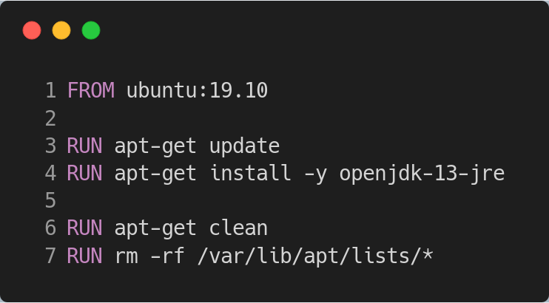
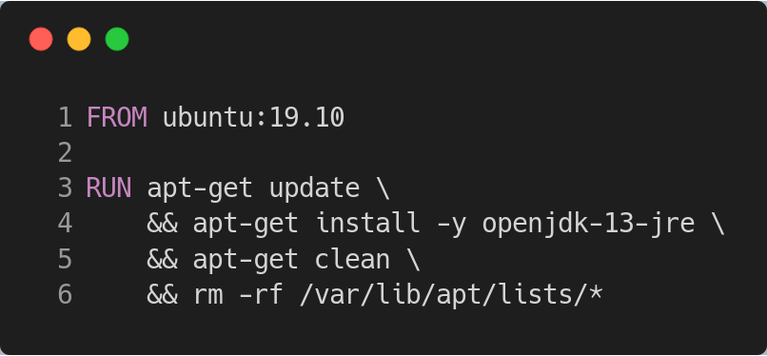
Docker Images
What is the difference regarding the resulting Docker image?

Slide 18
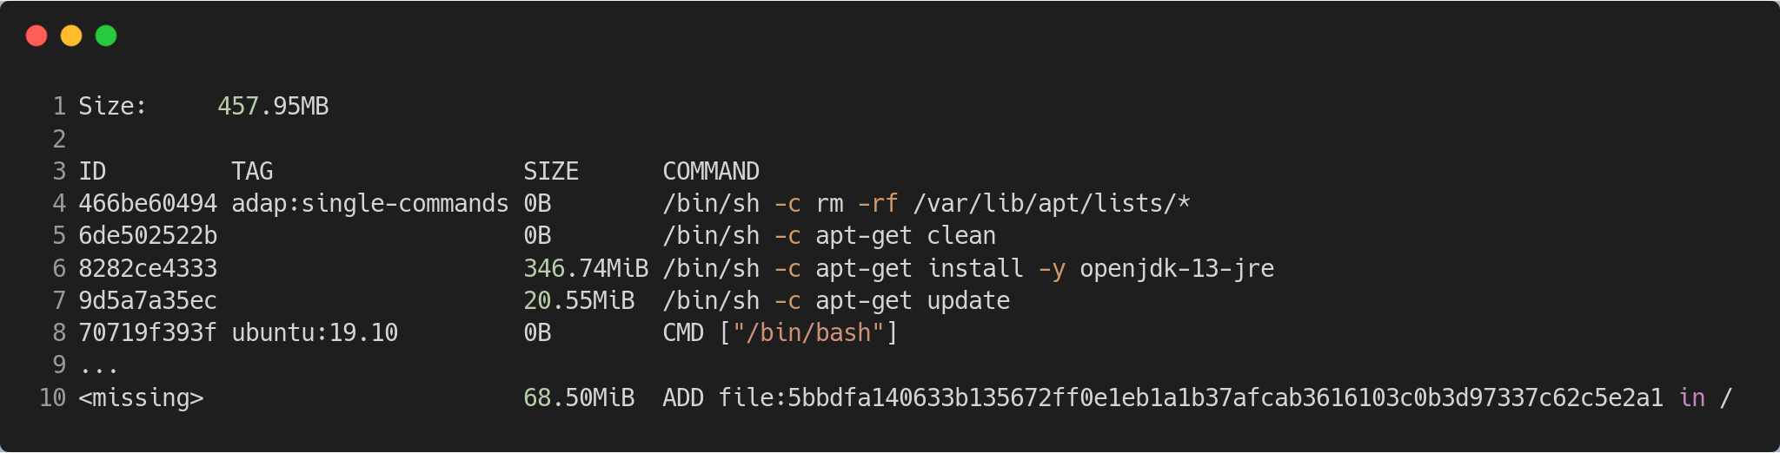
Docker Image Layers: Example multiple commands
Cleaning up with an extra RUN command doesn’t reduce the size of the image, it creates just a new layer with the information that the files does not exist anymore

Slide 19
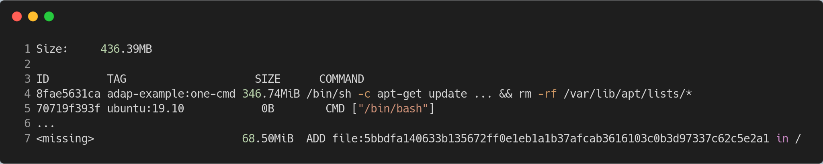
Docker Image Layers: Example only one command
Cleaning up within the same RUN command ensures that unnecessary files are not part of the resulting image

Slide 20
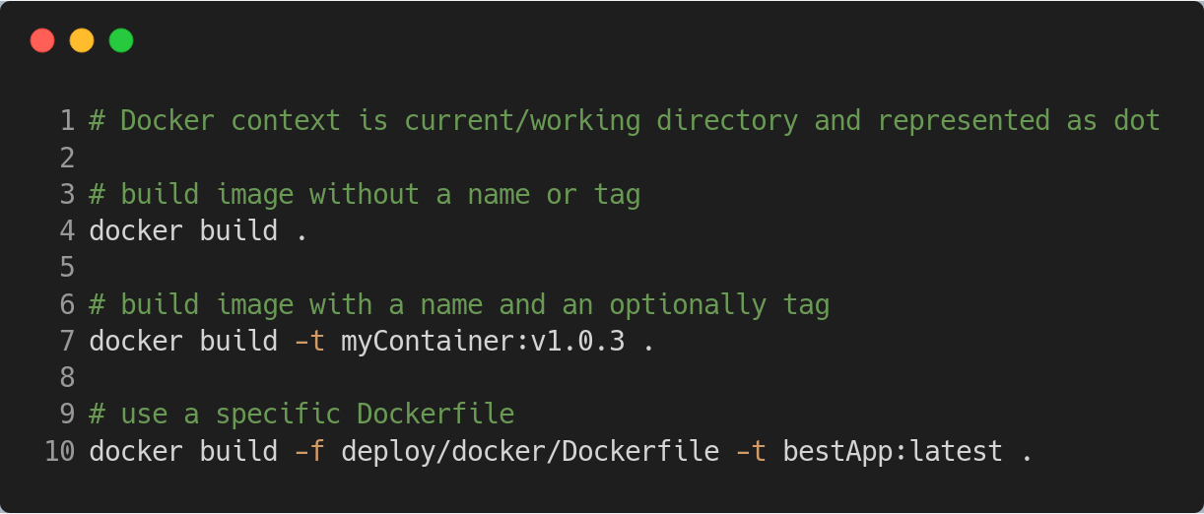
Docker Build Example
The docker build command builds an image from a Dockerfile and a context

Slide 21
Persistence in Docker
By default all file changes inside a container are stored on the writable container layer
  If the container is deleted, all file changes are also gone
  Writable container layer is tightly coupled to the host machine and can’t be moved easily
  Data depend on the lifecycle of the container
Docker provides the following options to store data on the host system
  Volumes (preferred option)
    A volume is stored within a directory on the host and is managed by Docker
  Bind mounts
    Mounting files or directories from the host system
Non-persistent mount with tmpfs (Linux only)
  Store data temporary in the host memory
  Often used to store secrets temporarily

Slide 22
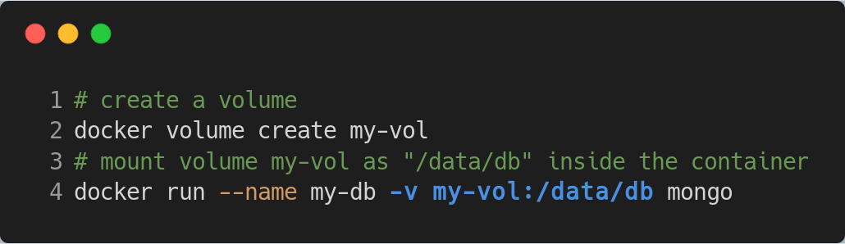
Persistence in Docker: Volumes
Volumes (preferred option)
  Created and managed by Docker
  A volume is stored within a directory on the host
  Easy to backup and snapshot
  Volumes can be shared among multiple containers
  Manage volumes using Docker CLI or API
  Volume drivers allows to store volume on a remote host (e.g. a cloud provider)
Example
  Store date of MongoDB outside the container in a volume

Slide 23
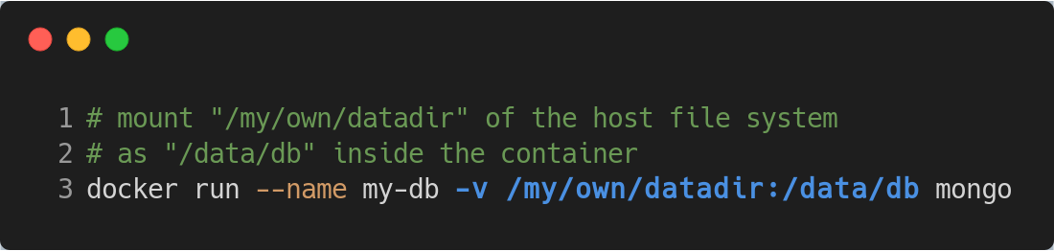
Persistence in Docker: Bind Mounts
Bind mounts
  Mount files or directories from the host system into a container
  Limited functionality compared to volumes
  File or directory will be created if does not exist already
  Allows easy sharing of config files or development artifacts to container
Example
  Store date of MongoDB outside the container

Slide 24
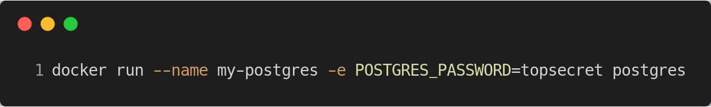
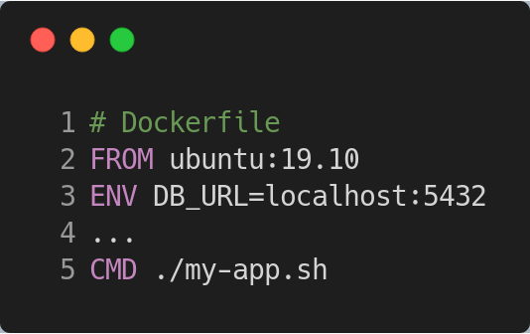
Docker Environment Variables
Environment variables allows us to configure a containerized application
  With the -e parameter you can pass environment variables from the host to the container
  With ENV you can define environment variables in the Dockerfile to provide default values
  To use environment variables during image build-time you need first to introduce the variable with the ENV instruction
  ARGs (build-time variables) can be used to pass variables during build-time
    Running container can’t access ARG values

Slide 25
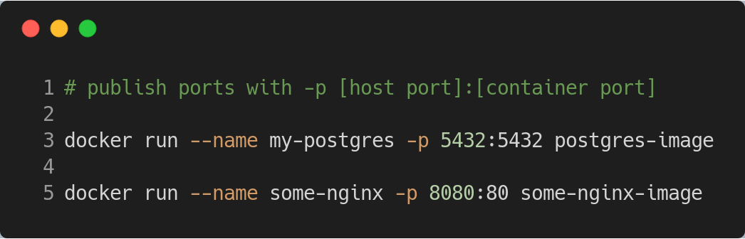
Publish a Container’s Port(s) to the Host
Default behavior: Host can’t access ports of processes inside a container
EXPOSE instruction inside Dockerfile declare ports used inside a container
  A way of documentation
Running container with option for port mapping is required
  Option -P publish all exposed ports to the host
  Option -p publish one or a range of ports to the host

Slide 26
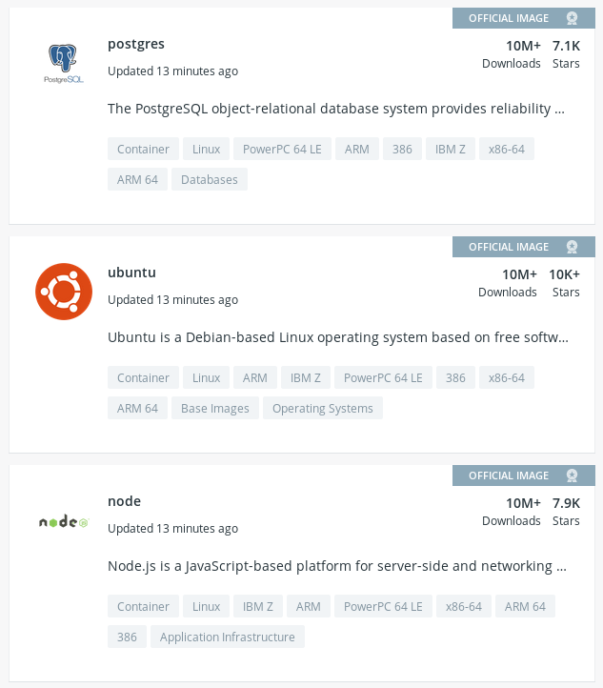
Share Images with the World or a Team
Docker Hub
Public and private image repositories allow to easy share and manage images
Docker Hub is the default repository for Docker

Slide 27
Docker Environment on different OS
Linux
  Containers are part of the Linux ecosystem
  Native isolated processes
  Direct access to the host Linux kernel
  Best performance
Mac (Docker for Mac)
  Lightweight virtual machine (LinuxKit) running on macOS Hypervisor
  No direct access to the network stack and native file mounts
  Uses Unix sockets to bridge host and Docker VM
Windows
  Runs LinuxKit VM with the virtualization tool Hyper-V
  Similar to Docker for Mac
Docker Toolbox (legacy solution for Mac and Windows)
  Runs a Linux VM using Virtual Box
  Bridges host and Docker VM via TCP connection
  Lower performance

Slide 28
Why Container Orchestration
Modern applications consist of smaller (micro)services that work together
This way a containerized application consists of multiple container that communicate over network to provide a service
Managing containers becomes a complex task
  E.g. deploying the whole application requires custom scripts
The process of organizing multiple container is called container orchestration [1]
Container orchestration solutions
  Docker Swarm by Docker Inc
  Kubernetes based on Google’s work (the gold standard)
  Mesos by Apache
[1] https://www.hpe.com/de/de/what-is/container-orchestration.html

Slide 29
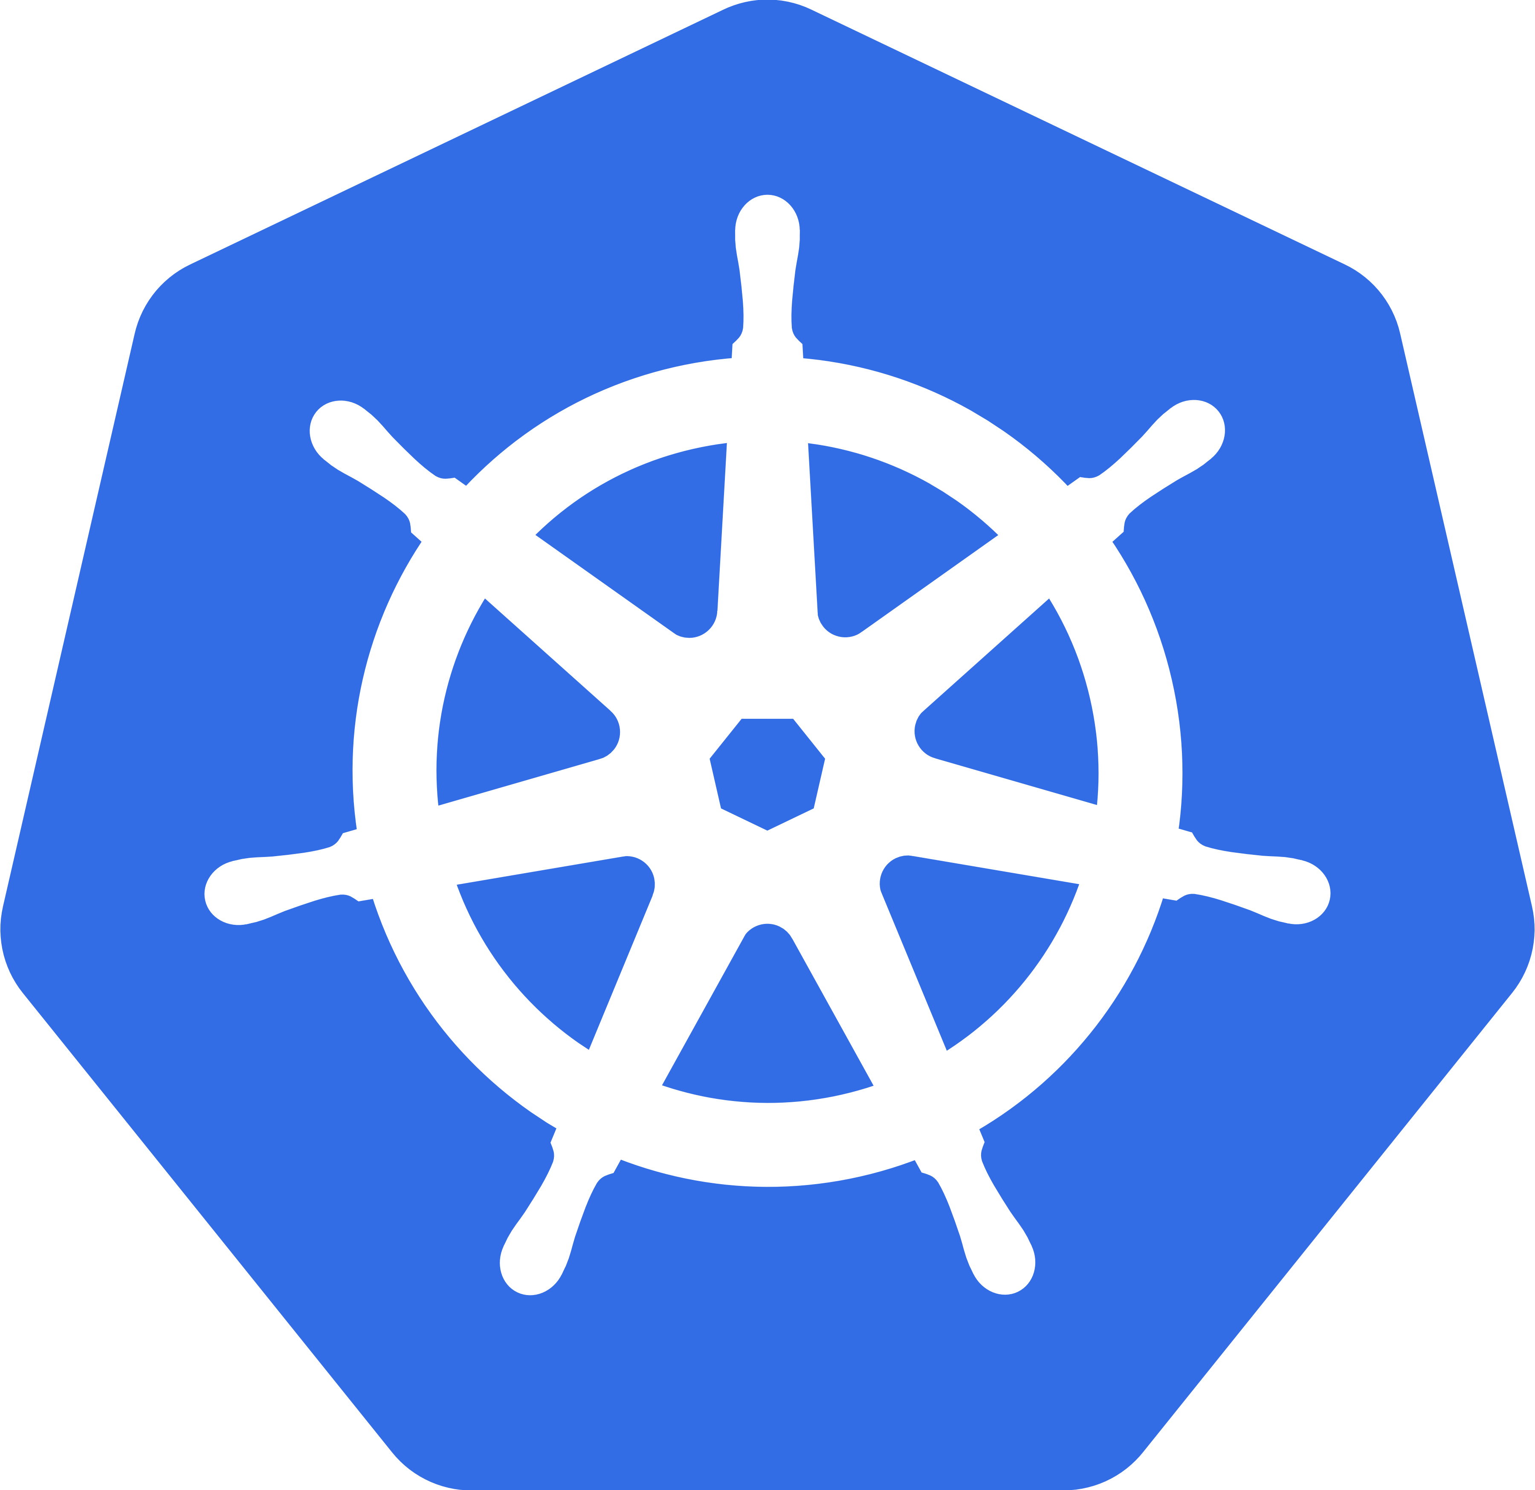

Container Orchestration
“Kubernetes (K8s) is an open-source system for automating deployment, scaling, and management of containerized applications.” [2]
Horizontal scaling (for medium to large clusters)
  Spawn new instances of services either by hand, or
  Automatically based on metrics like CPU usage
  Optimized usage of a cluster’s resources
Service discovery and load-balancing
Self-healing features
  like restart on failure with health monitoring
Manage deployments
  Define deployment units
  Automated rollouts and rollbacks
Image: https://github.com/kubernetes/kubernetes/tree/master/logo
[2] https://kubernetes.io/

Slide 30
Thank you! Questions?
dirk.riehle@fau.de – https://oss.cs.fau.de
dirk@riehle.org – https://dirkriehle.com – @dirkriehle
DR

Slide 31
Legal Notices
License
  Licensed under the CC BY 4.0 International License
Copyright
  © 2019-2021 Friedrich-Alexander University Erlangen-Nürnberg, some rights reserved
Contributions
  Andreas Bauer (2019)
  Georg Schwarz (2019-2021)

